Slide 1
ETA Scoping Study Investigate feasibility, cost, and implementation of this proposed DIM mounted component
Jedlovec, et al, September 27, 2016

Slide 2
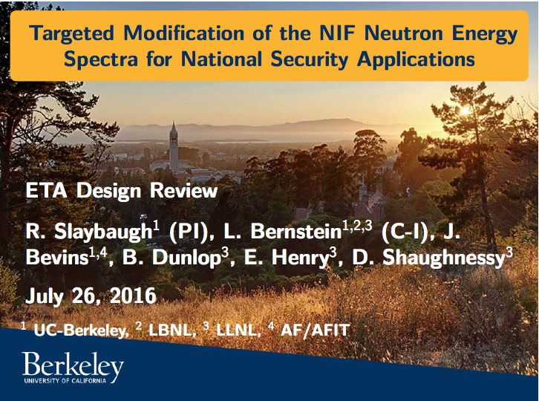
ETA Scoping Study – Physics Basis

Slide 3
ETA Scoping Study – ETA overview

Slide 4
ETA Scoping Study – ETA NIF requirements

Slide 5
ETA Scoping Study – ETA Assembly

Slide 6
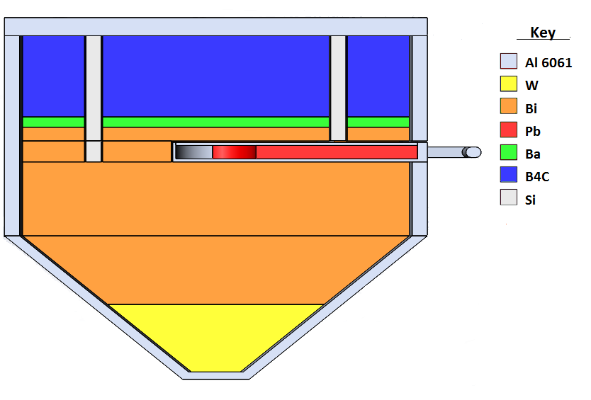
ETA Scoping Study – ETA materials

Slide 7
ETA Scoping Study – Feasibility and Cost
Activation: Handling the activated item should not be a problem, for example, <5mR/h at 1ft after one hour for 1E15shot, from Hesham’s activation analysis.
Fission Product inventory point of view: Jim Watson sees no show stoppers, ETA will look very much like the HEU toad he has analyzed before
Cleanliness: all materials should be acceptable
Hazardous Materials: the HRC is OK with the use of these materials, but no formal analysis has been performed. Lead will have to be encapsulated, unless the assembly itself is provided in a sealed configuration.
Fabrication: American Elements. We have a quote for $50K. General Atomics is also a possibility. Chris Bailey has reviewed.
DIM: ETA mass and position can be optimized not to exceed rated DIM moment. No DIM changes, merely design the ETA interface
Cost: ($290K) remarkably similar to our initial estimate of $310K
Radchem: $100K for MP for chemical processing, for counting, and for consumables.
TD manpower for design, analysis, deployment, commissioning: $130K
Procure ETA assembly $60, includes ETA plus mounting and DIM interface components
Low risk, no show stoppers, cost is reasonable and in line with our original estimates

Slide 8
ETA Scoping Study – Summary
Low risk, no show stoppers, cost is reasonable and inline with our original estimates ($60K procurements, $230K labor, of which $130K is TD)
Given resources and a high priority, ETA could be deployed in 4-6 months

Slide 9

ETA Scoping Study – End

